Slide 1


PROJECT PHASE – 1
REVIEW - 2
:
SOHAN R V
MALLIKAJUNA R
LIKITH H
KAVIYARASU K
TEAM MEMBERS
[ENG21CT0037]
[ENG21CT0012]
[ENG21CT0019]
[ENG22CT1001]
GUIDE
:
PROF. YASHASWINI B V
DEPARTMENT
:
COMPUTER SCIENCE & TECHNOLOGY

Slide 2
AGENDA
ABSTRACT
INTRODUCTION
LITERATURE SURVEY
RESEARCH GAP
PROBLEM STATEMENT
PROPOSED METHODOLOGY
ROADMAP
REFERENCES

Slide 3
TITLE OF OUR PROJECT
ENHANCED CNN AND FEDERATED LEARNING ALGORITHM FOR SECURE AND PRECISE DERMATOLOGICAL DIAGNOSIS.

Slide 4
ABSTRACT
The diagnosis of skin diseases, a prevalent global health concern, often begins with visual observation. However, the complex formations, diverse colors, and data security concerns make accurate classification challenging. This project proposes the development of an enhanced Convolutional Neural Network (CNN) model integrated with a Federated Learning approach to ensure secure and precise dermatological diagnosis. A custom image dataset encompassing five skin disease classes was created for this purpose. The CNN model was compared with various benchmark algorithms, demonstrating significant improvements in precision and recall for diseases such as acne, eczema, psoriasis, melanoma, and lichen planus. Federated Learning was employed to address data privacy issues by distributing data across multiple clients while collaboratively updating a central model. The results show that the integration of CNN-based classification with Federated Learning not only enhances accuracy but also prioritizes data security, making it a promising approach for advancing skin disease detection.

Slide 5
INTRODUCTION
Skin diseases are typically diagnosed visually, but their complex formations and privacy concerns make accurate classification difficult.
The project develops an enhanced CNN model integrated with Federated Learning to provide secure and precise dermatological diagnosis.
Using a custom dataset of five skin disease classes, the model improves classification accuracy and data privacy by distributing data across clients and updating a central model collaboratively.

Slide 6
LITERATURE
SURVEY

Slide 7
NO. | STUDY | METHODOLOGY | FINDINGS | LINK
1 | Integrating Attention Mechanism for Cancer Diagnosis-2024 | Single CNN Model enriched with attention mechanism for Skin Cancer Detection Highlighting Critical Lession Features | Acheived accuracy of 81% using 1,12,707 Datasets | https://ieeexplore.ieee.org/document/10481565
2 | Improving Skin Lesion Diagnosis: Hybrid Blur Detection for Accurate Dermatological Image Analysis-2021 | Shape analysis algorithms capture intricate shape features of skin lesions, which are then utilized by a deep learning model trained on a diverse dataset of dermatological images. | Acheived accuracy of 80% using 200 Datasets of Skin Lesion Cases | https://ieeexplore.ieee.org/document/10607639
3 | Utilizing Deep Neural Networks for Enhanced Diagnosis of Dermatological Conditions -2022 | With DNN Model enriched with DenseNet-161 & NasNet | Using two publicly available datasets of Skin Images : DermNet & ISIC Archieve with the acuuracy of 80% with 23,000 over 1st & 24,000 over 2nd collections. | https://ieeexplore.ieee.org/document/10544747

Slide 8
NO. | STUDY | METHODOLOGY | FINDINGS | LINK
4 | Enhanced Skin Cancer Classification with AlexNet and Transfer Learning-2023 | With DNN Model enriched with DenseNet-161 & NasNet | Using two publicly available datasets of Skin Images : DermNet & ISIC Archieve with the acuuracy of 80% with 23,000 over 1st & 24,000 over 2nd collections. | https://ieeexplore.ieee.org/document/10544747
5 | Performance Improvement of Convolutional Neural Network Architectures for Skin Disease Detection | CNN with AlexNet Combination of ZF Net Hybridization of the networks | AlexNet Algorithm shows the accuracy upto 76.44% Accuracy of 73.75% was obtained on ZF Net Algorithm | https://www.researchgate.net/publication/373191569
6 | Classification of skin lesions using transfer learning and augmentation with Alex-net | Alex Net with Transfer Learning Combination of the Networks | Accuarcy obtained is 71.4 % | https://doi.org/10.1371/journal.pone.0217293

Slide 9
RESEARCH GAP
Limited privacy-preserving solutions for dermatological diagnosis using deep learning.
Existing models struggle with performance issues on decentralized and heterogeneous datasets.
Lack of scalable and secure deployment for real-world healthcare applications.
Insufficient use of Federated Learning to address data privacy concerns in dermatology.
Current approaches lack the integration of advanced CNN architectures for improved diagnostic accuracy.

Slide 10
PROBLEM STATEMENT
Diagnosing skin diseases is difficult due to visual similarities and complex variations.
Traditional methods and deep learning models often result in errors due to these challenges.
Data privacy concerns restrict the availability of large, labeled datasets for training machine learning models.
Federated Learning combined with advanced CNN models addresses privacy and accuracy challenges.

Slide 11
PROPOSED
METHODLOGY

Slide 12
Enhanced CNN Architecture (EfficientNet, ResNet-152) for improved feature extraction and accuracy.
Federated Learning Integration using FedAvg and FedProx for secure and decentralized training.
Edge AI Deployment on devices like Raspberry Pi or Jetson Nano with model optimization (quantization/pruning).
Real-Time Feedback System with a GUI for image uploads, predictions, and result visualization.

Slide 13
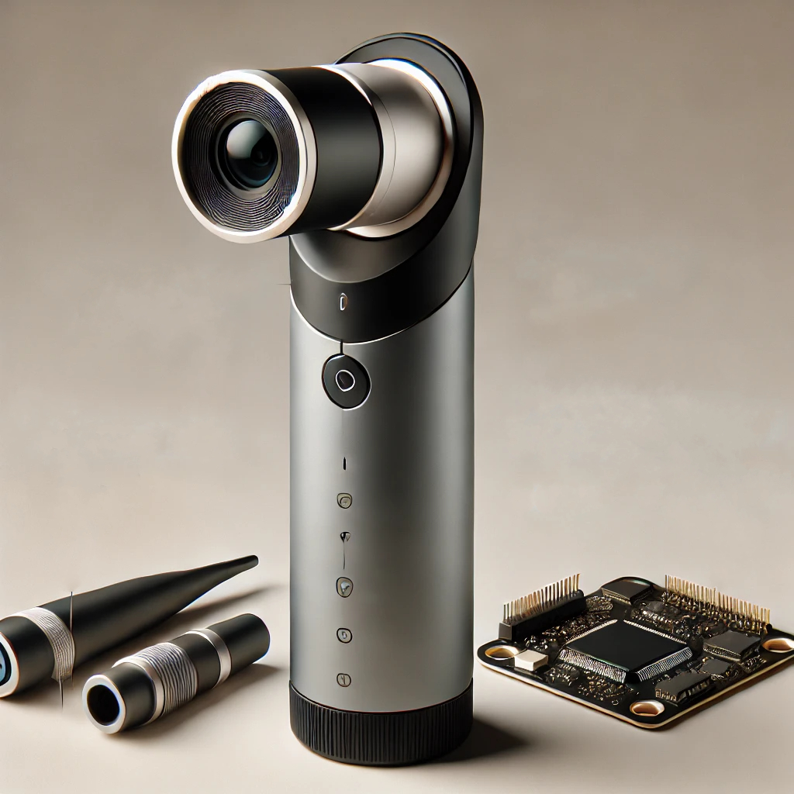
Hardware Design Implementation
Magnifier-Like Device: Custom-built hardware component for detailed skin disease examination.
High-Resolution Camera: Integrated for capturing magnified images of the affected area.
Edge Processing Unit: Embedded system (Raspberry Pi / Jetson Nano) for real-time diagnosis.
User Interface: Touchscreen or mobile app to display results and interact with the device.

Slide 14
ROAD
MAP

Slide 15
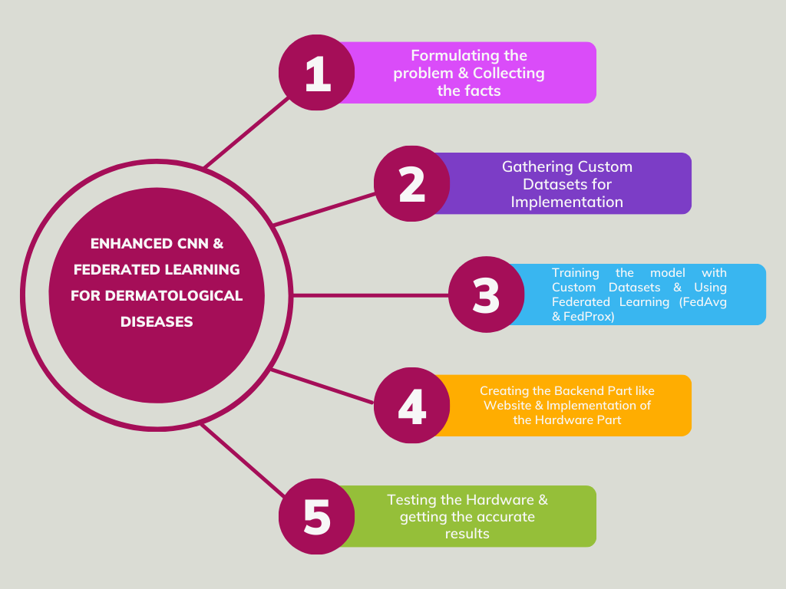

Slide 16
CONCLUSION
In conclusion, the integration of an enhanced Convolutional Neural Network (CNN) model with Federated Learning presents a promising approach to addressing the challenges associated with skin disease diagnosis. By automating the classification process, this methodology not only enhances diagnostic accuracy but also mitigates the risks associated with data privacy and security inherent in traditional centralized models. The use of advanced CNN architectures, such as Efficient-Net or ResNet, allows for effective handling of the complexities involved in skin disease classification, while Federated Learning ensures that sensitive patient data remains secure by facilitating local model training. Ultimately, this combined approach represents a significant advancement in dermatological diagnostics, offering a more reliable and secure solution that can be adapted to diverse clinical environments.

Slide 17
REFERENCES

Slide 18
[1] A. Vaswani, N. Shazeer, N. Parmar, J. Uszkoreit, L. Jones, A. N. Gomez, L. Kaiser, I. Polosukhin, Attention is all you need (2023). arXiv: 1706.03762.
[2] Shao, Y., Zhang, J., Ye, J., Zhang, J., & Li, Z. (2020). A Hybrid Approach for Skin Lesion Segmentation and Blur Detection. IEEE Access, 8, 60141-60152.
[3] G. Litjens, T. Kooi. A.A. Seti, F. Ciompi, M. Ghafoorian, J.A. Van Der Laak, B. Van Ginneken, and C.I. Sánchez, "A survey on deep learning in medical image analysis", Medical image analysis, 42, pp.60-88, 2023.
[4] Esteva et al., “Dermatologist-level classification of skin cancer with deep neural networks,” Nature, vol. 542, pp. 115–118, 2017.S. Jinnai, N. Yamazaki, Y. Hirano, Y. Sugawara, Y. Ohe.
[5] G. Algan and I. Ulusoy, “Image classification with deep learning in the presence of noisy labels: A survey,” Knowledge-Based Systems, vol. 215, p. 106771, 2021.
[6] Codella N., Nguyen Q., Pankanti S., GutmanD., Helba B.,Halpern A., SmithJ., “Deeplearning ensem bles for melanomarecognition in dermoscopy images”, IBM Journal of Research andDevelopment. Vol. 61, no.4/5, pp. 5:1–5:15, 2019.

Slide 19
THANK
YOU

